Slide 1
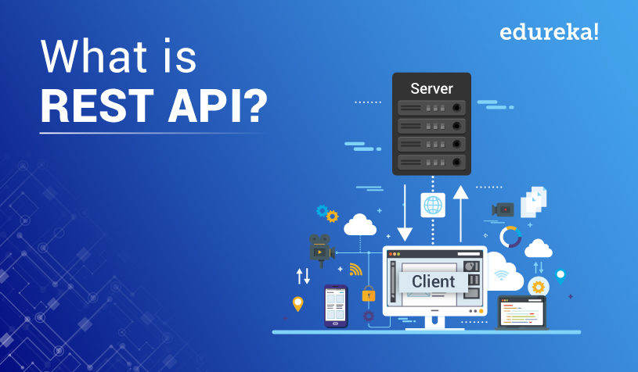
IoE

Slide 2
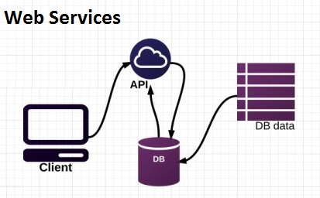
Introduction
Today, almost every application on the internet does need to provide interoperability as a basic feature.
At any given moment, applications are communicating with other applications (for example, a mobile application communicating with a web application).
Thus, it is important that all applications should be able to communicate with other applications without depending on the underlying operating system and the programming languages. Web services are used to create such applications.

Slide 3
Web Services
A web service is a collection of standards and protocols that applications and systems use for exchanging data over the internet. A web service could be written in any programming language and is OS-independent.
For instance, an application built in PHP running on a Linux server can communicate with an Android application built using Java and running on an Android operating system.

Slide 4
What Is REST?
REST stands for Representational State Transfer.
It is a stateless software architecture that provides many underlying characteristics and protocols that govern the behavior of clients and servers.

Slide 5
What Is Meant by RESTful?
An API that has following features is known as RESTful API:
Client-server architecture: The client is the front-end and the server is the back-end of the service. It is important to note that both of these entities are independent of each other.
Stateless: No data should be stored on the server during the processing of the request transfer. The state of the session should be saved at the client’s end.
Cacheable: The client should have the ability to store responses in a cache. This greatly improves the performance of the API.

Slide 6
What Is a RESTful API?
A RESTful API (also known as a RESTful web service) is a web service implemented using HTTP protocol and the principles of REST. It is a collection of resources that employ HTTP methods (GET, PUT, POST, DELETE).
The collection of the resources is then represented in a standardized form (usually XML) that can be any valid Internet media type, provided that it is a valid hypertext standard.

Slide 7
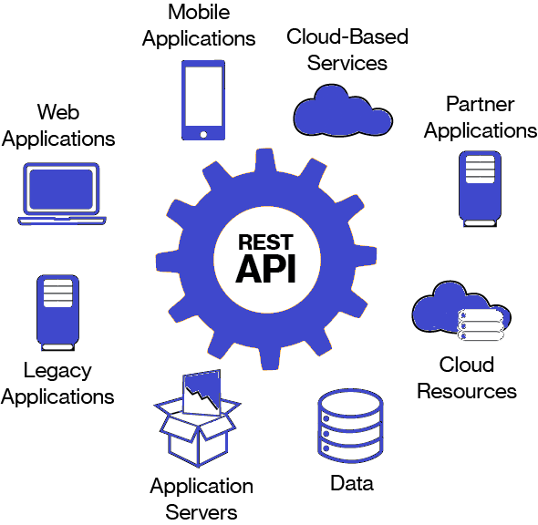

Slide 8
Req and Response
Popular RESTful API request formats:
Popular RESTful API response formats:
REST
XML-RPC
SOAP
REST
XML-RPC
SOAP
JSON
PHP

Slide 9
Why Use a RESTful API?
A RESTful API is used to make applications distributed and independent over the internet with the aim of enhancing the
performance,
scalability
simplicity
modifiability
visibility
portability
reliability of the application

Slide 10
Summary
REST (Representational State Transfer) is a way of accessing the web services. REST as an architecture style does not require processing and is more simple and flexible than SOAP(Simple Object Access Protocol) which is another standards-based Web services access protocol developed by Microsoft.
REST is much easier and more widely used than SOAP (about 70% web services API uses REST API) and is the newcomer to the block which seeks to fix all problems with SOAP.

Slide 11
We used REST API to fetch or give some information from a web service. It is as simple as giving an HTTP GET or POST or PUT or DELETE request from the client (Mobile Application, A website etc.) to the server to get some information from the server or to give some information to the server.
The REST based web services can give output in any format like Command Separated Value (CSV), JavaScript Object Notation (JSON) and Really Simple Syndication (RSS).
The point is that you can obtain the output you need in a form that’s easy to parse within the language you need for your application. A sample REST API diagram is given below.

Slide 12
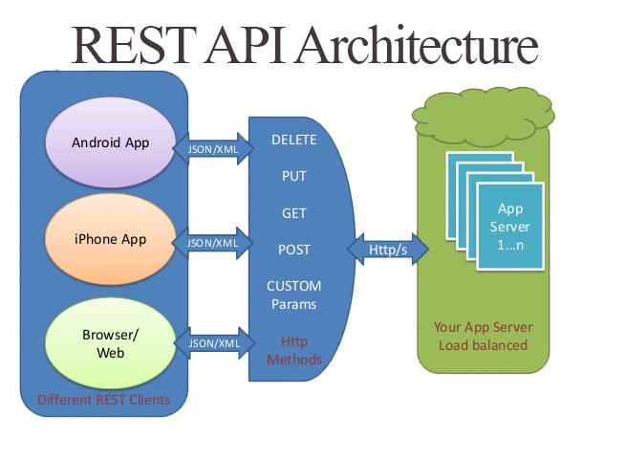

Slide 13
Real-World RESTful API Examples
All the most popular websites and social media offer RESTful API. Several popular examples include:
Cloudways REST API
The Twitter REST API
Facebook REST API
Google Translate REST API
Magento REST API

Slide 14
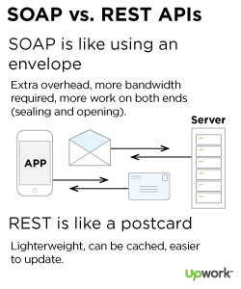
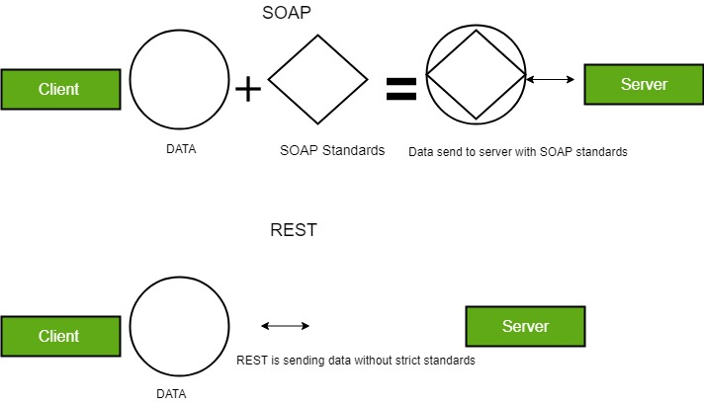

Slide 15
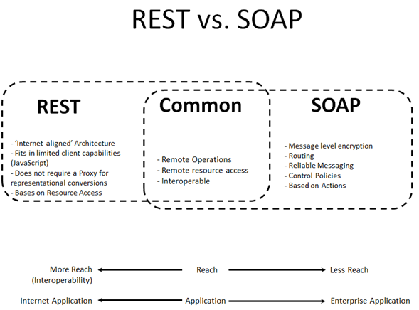

Slide 16
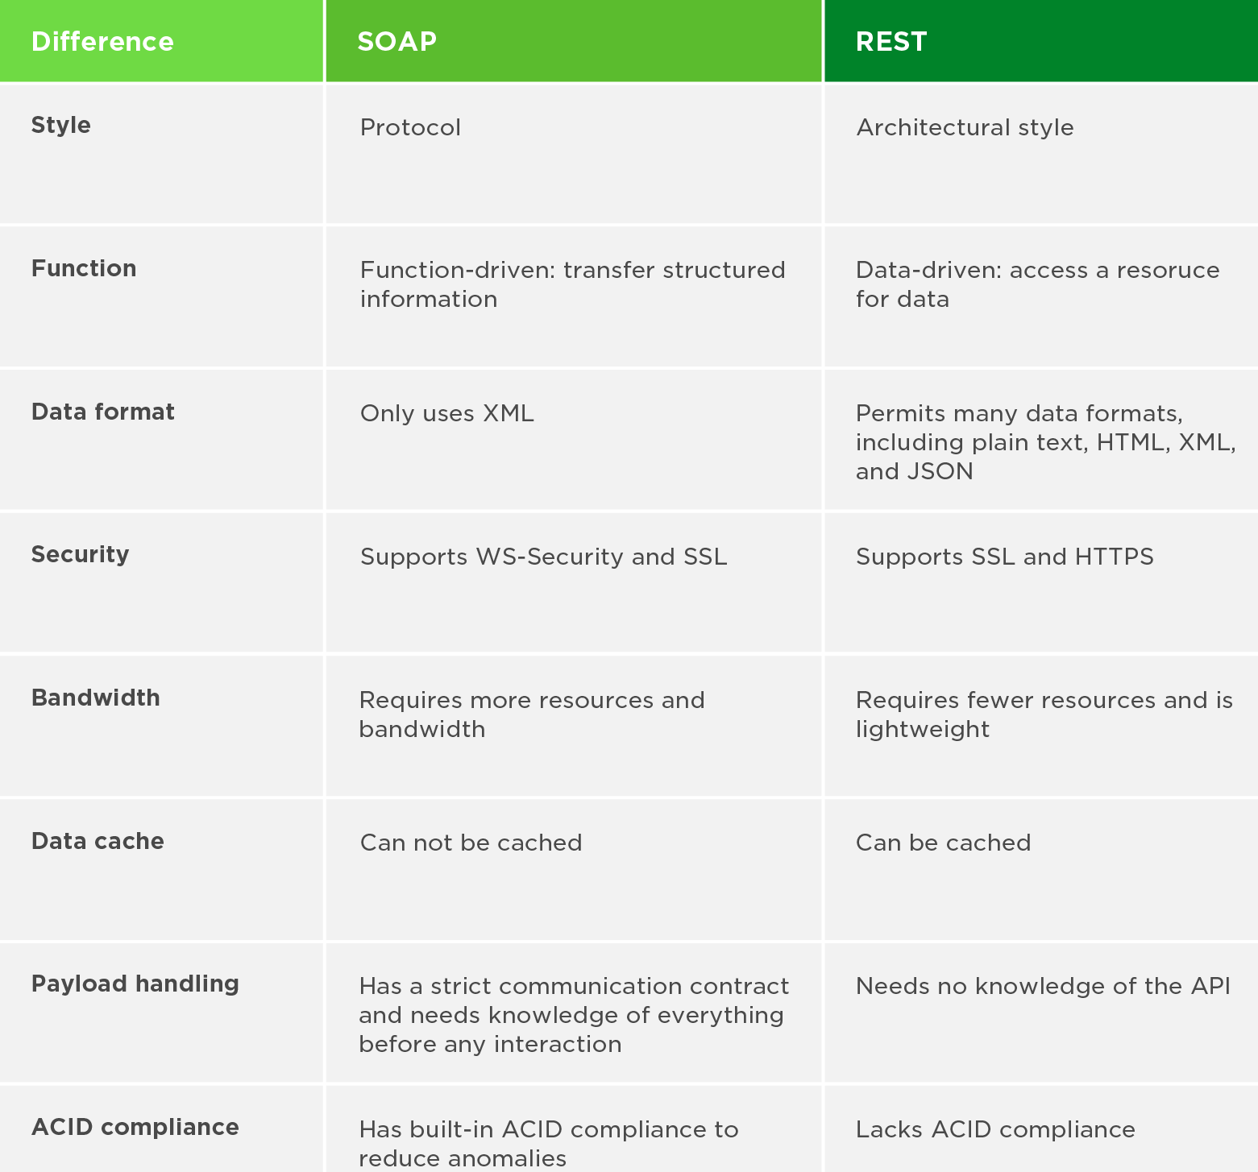

Slide 17
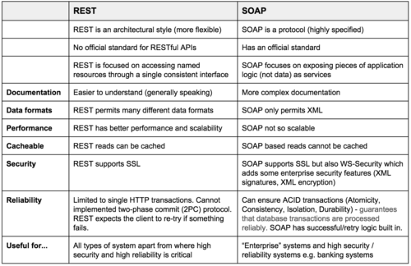

Slide 18
References
https://shareurcodes.com/blog/creating%20a%20simple%20rest%20api%20in%20php

